Slide 1
Analyzing recruitment of Riboglow to stress granules
Erin Richards and Rosie Garris SWEFS, Group 5

Slide 2
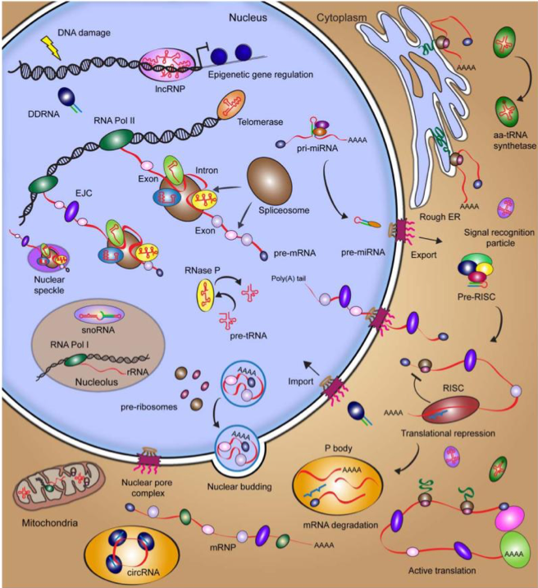
Proper RNA localization is critical for cellular function
Pitchiaya 2014 Chem Rev

Slide 3
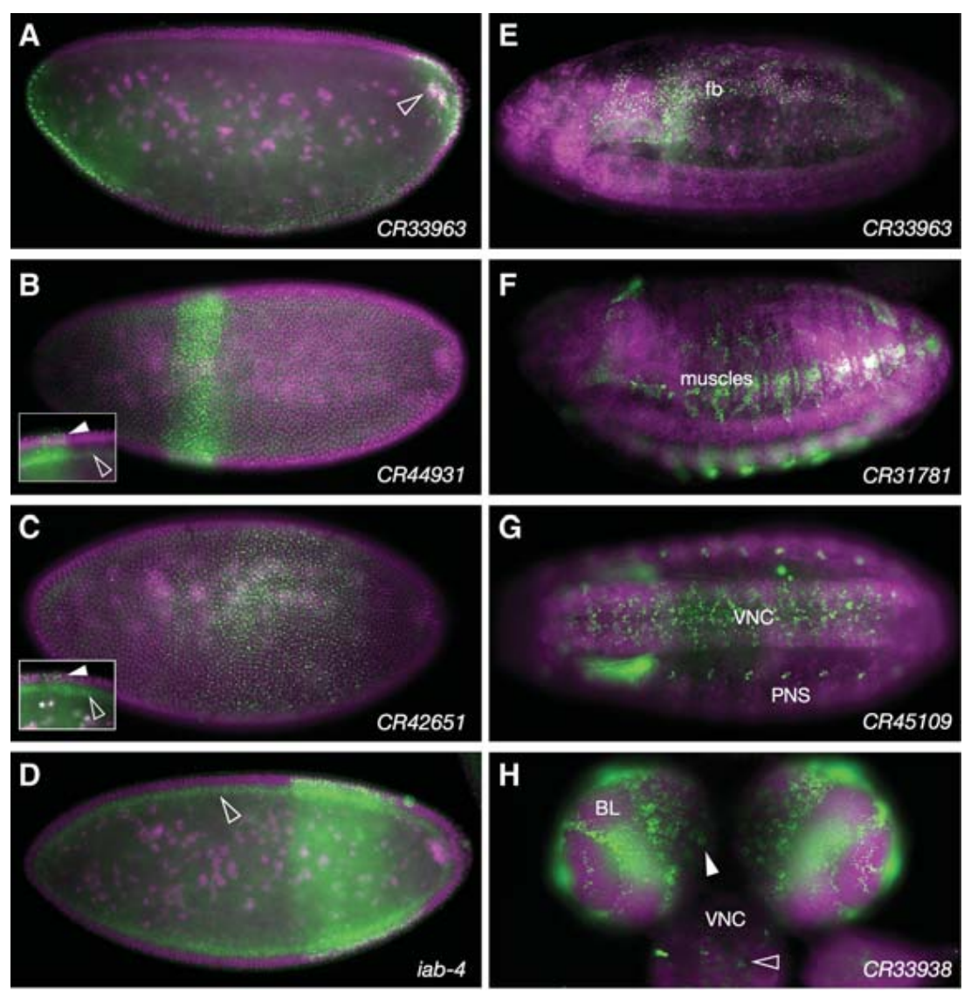
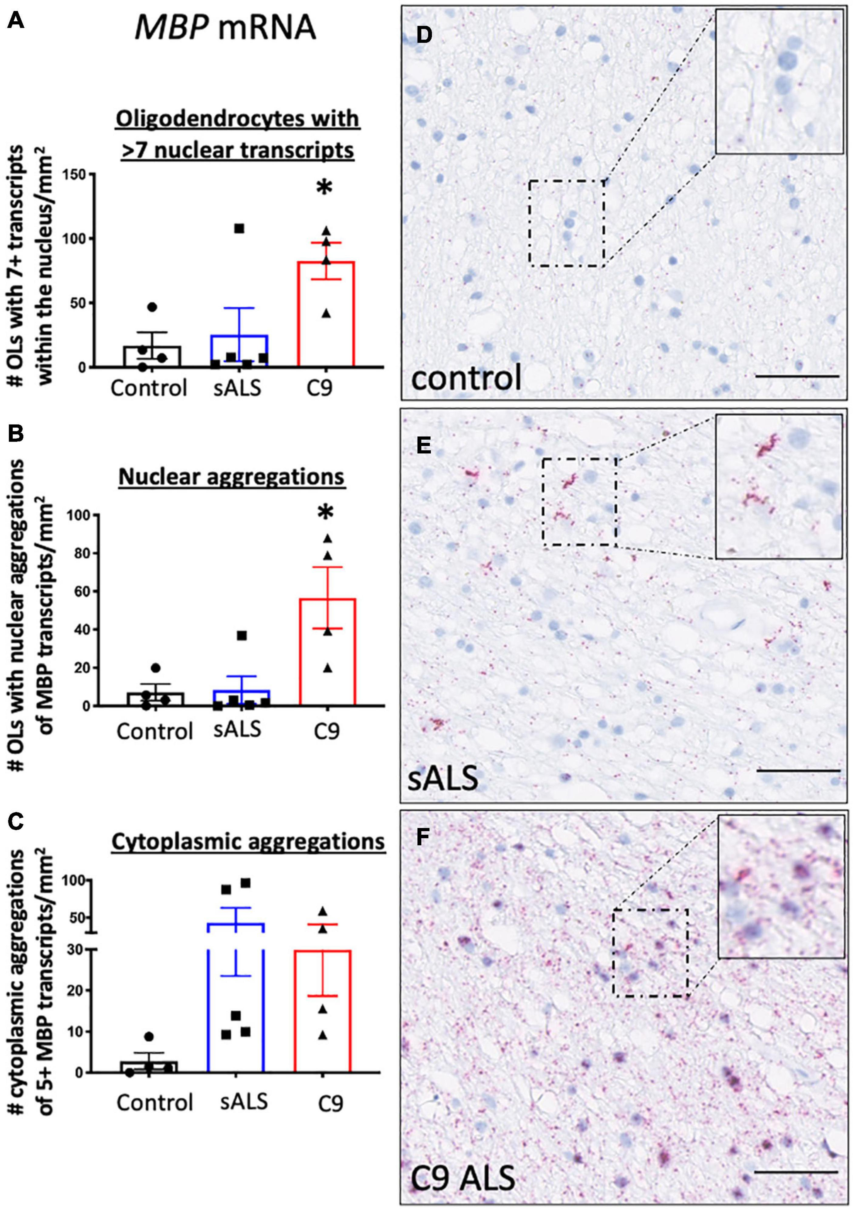
RNA localization is critical for organism development and health
Wilk 2016 Genes and Dev
Barton 2021 Front Neurosci

Slide 4
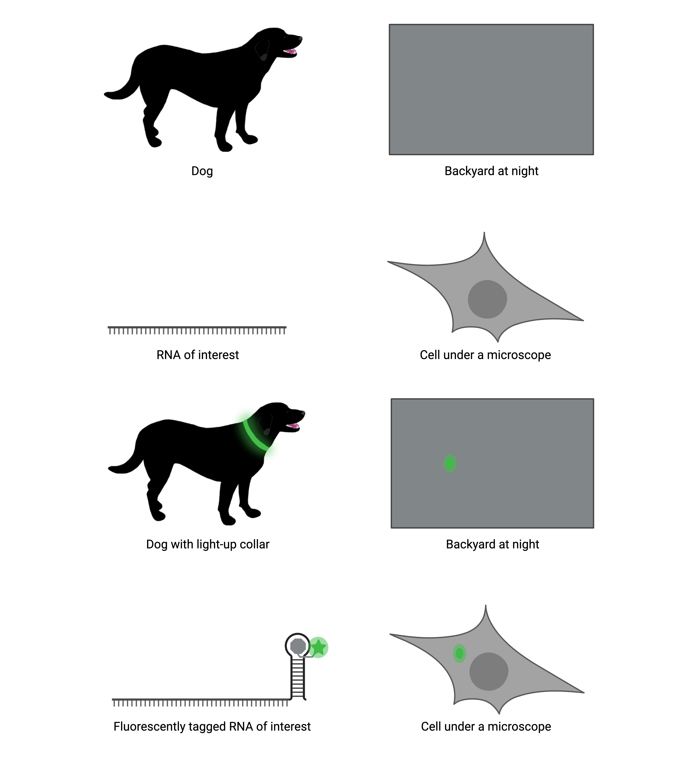
Fluorescent RNA tools allow us to see our favorite RNA in live cells

Slide 5
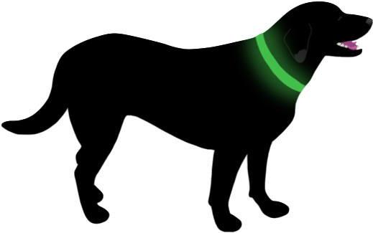
Fluorescent RNA tools allow us to see our favorite RNA in live cells
Biology is heterogenous between different cell types.

Slide 6
Fluorescent RNA tools allow us to see our favorite RNA in live cells
Biology is heterogenous between cells of the same type.

Slide 7
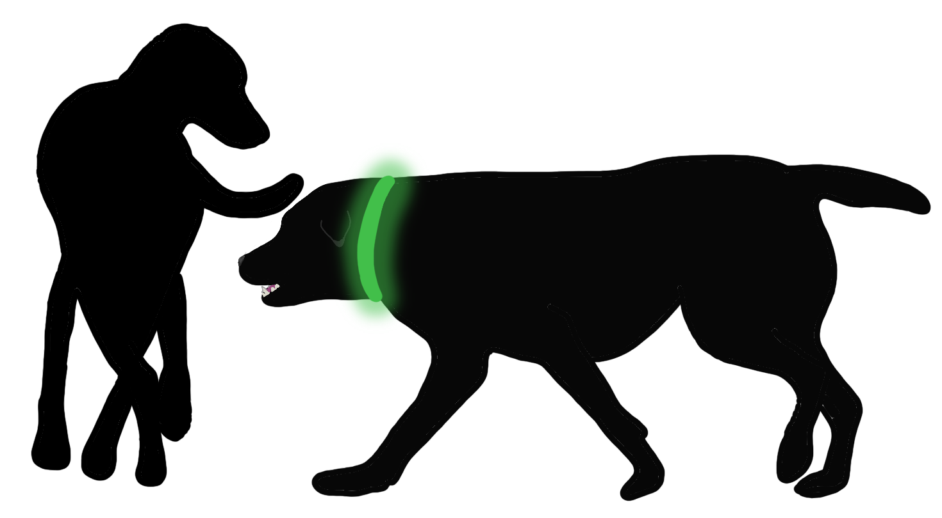
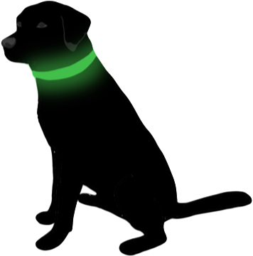
Fluorescent RNA tools allow us to see our favorite RNA in live cells
Biology is heterogenous between molecules of the same type
in the same cell.

Slide 8
Fluorescent RNA tools allow us to see our favorite RNA in live cells
Biology is heterogenous between the same molecule in the same cell
over time.

Slide 9
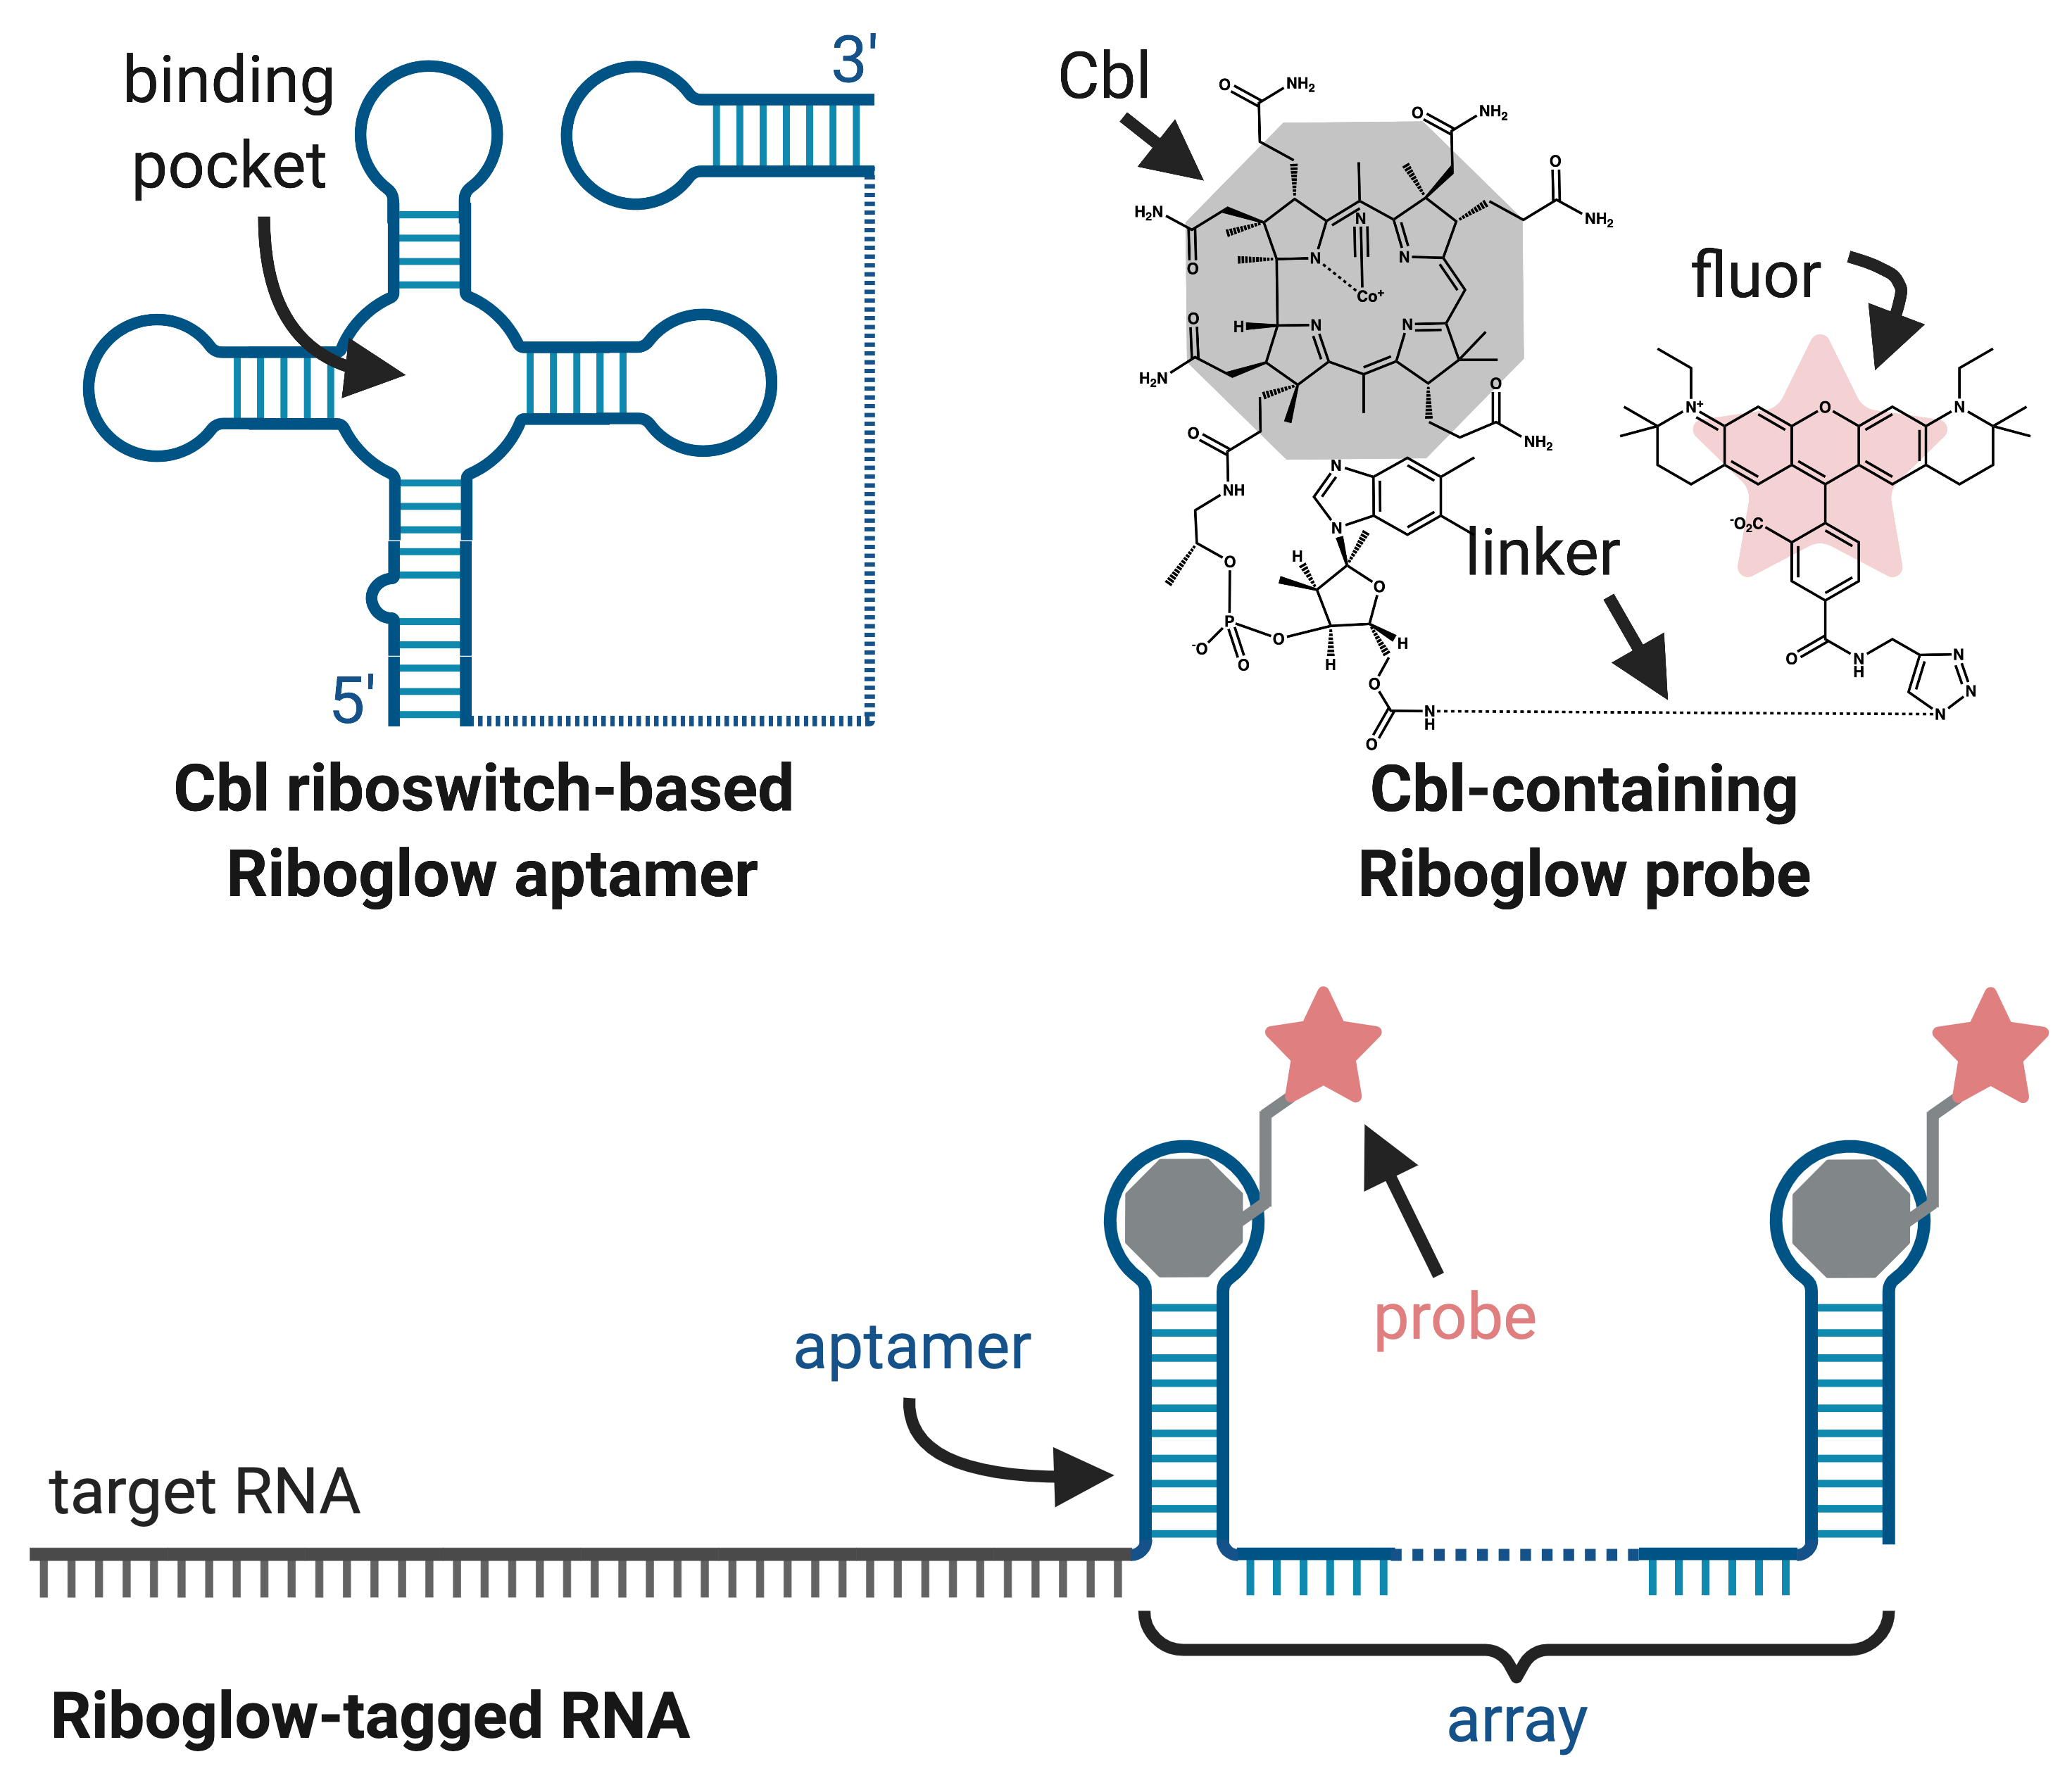
Riboglow is a two-part fluorescent RNA tool
Riboglow aptamer
Riboglow probe

Slide 10
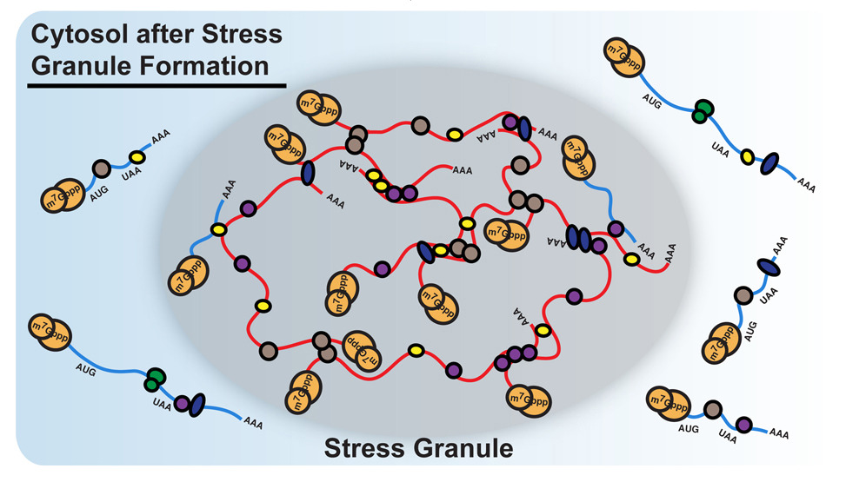
Cells form protein-RNA aggregates called stress granules under stress
Khong 2017 Mol Cell

Slide 11
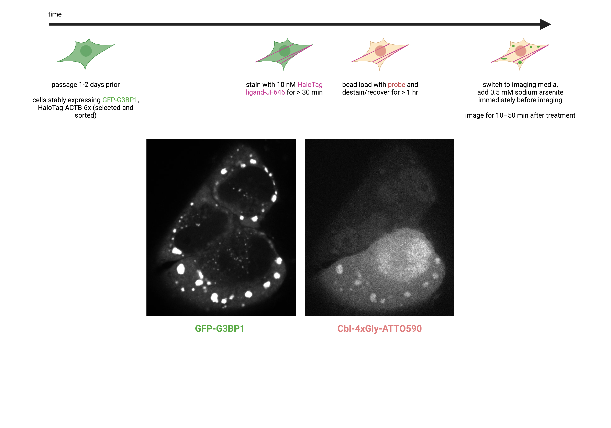
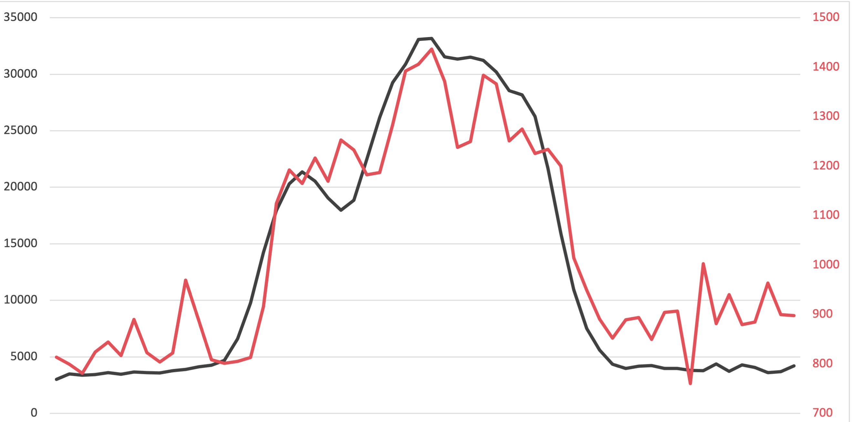
Riboglow-tagged RNA gets recruited to stress granules
stress granule marker
Riboglow probe
fluorescence intensity
distance

Slide 12
How efficiently are Riboglow-tagged RNAs recruited to stress granules?
What proportion of stress granules in a cell contain Riboglow probe? How enriched is Riboglow probe in the stress granules compared to background levels in the cytosol?
Does a newer version of Riboglow perform better in this assay than the original Riboglow system?

Slide 13
Overall workflow
Segment cells
Detect granules
Count granules
Overall inputs:
Three-channel images
Overall outputs:
Fraction of granules that contain Riboglow probe
Enrichment of Riboglow probe in granules over background
Comparison of new version of Riboglow to original version
Calculations
Statistics and visualization
Get probe intensity

Slide 14
Segment Cells
Segment cells For each image in each group
Inputs:
800x1000-pixel, three-channel images (.tif)
C2: Riboglow probe
C3: Expression marker for Riboglow-tagged RNA
Outputs:
Mask (list of lists) of cells in the images that have Riboglow probe and are expressing the Riboglow-tagged RNA

Slide 15
Segment Cells
Detect granules For each cell in each image in each group
Inputs:
800x1000-pixel, three-channel images (.tif)
C1: Stress granule marker
C2: Riboglow probe
Mask (list of lists) of cells in the images that have Riboglow probe and are expressing the Riboglow-tagged RNA
Outputs:
Mask (list of lists) of granules in granule marker channel
Mask (list of lists) of granules in Riboglow probe channel

Slide 16
Segment Cells
Count granules For each cell in each image in each group
Inputs:
Mask (list of lists) of granules in granule marker channel
Mask (list of lists) of granules in Riboglow probe channel
Outputs:
Number of granules in granule marker channel (total granules)
Mask (list of lists) of granules that overlap in granule marker channel and Riboglow probe channel
Number of granules that overlap in granule marker channel and Riboglow probe channel (overlapping granules)

Slide 17
Segment Cells
Get probe intensity For each granule in each cell in each image in each group
Inputs:
Mask (list of lists) of granules that overlap in granule marker channel and Riboglow probe channel
800x1000-pixel, three-channel images (.tif)
C2: Riboglow probe
Outputs:
Average Riboglow probe intensity in mask of overlapping granules (Riboglow probe intensity in granules)
Average Riboglow probe intensity in mask that is a ring around overlapping granules (Riboglow probe intensity in background)

Slide 18
Segment Cells
Calculate For (each granule in) each cell in each image in each group
Inputs:
Number of total granules
Number of overlapping granules
Average Riboglow probe intensity in granules
Average Riboglow probe intensity in background
Outputs:
Ratio of overlapping granules: total number of granules
Ratio of average Riboglow probe intensity granules: average Riboglow probe intensity in background

Slide 19
Segment Cells
Statistics and visualization For each cell in each group
Inputs:
Ratio of overlapping granules: total number of granules
Ratio of average Riboglow probe intensity granules: average Riboglow probe intensity in background
Outputs:
Statistical comparison of new version of Riboglow to original version
Violin plot of fraction of granules that contain Riboglow probe
Violin plot of enrichment of Riboglow probe in granules over background

Slide 20
Segment Cells
Overall Python script architecture
Parse input arguments.
Import images.
Feed imported images into cell segmentation function.
Feed cell masks into granule detection function.
Feed granule masks into counting function.
Feed overlapping granule masks into probe intensity function.
Feed counts and average probe intensities into calculation functions.
Feed calculations into statistics and visualization functions.

Slide 21
Segment Cells
Overall bash script architecture
Define environment.
Run overall Python script with input arguments (config file).
Record results and errors.
Report exit code.

